Slide 1



Slide 2

Table of contents
Your animators
Why a serious game ?
Context
Various Cards
Mechanics of the game

Slide 3

Your animators
What is UX for you ?
Nahel Chokairi
UX/UI Designer

Slide 4
Why a Serious game ?
Serious Game : a game for educational, informal or communicative purposes
Objective: to learn in a group on a complex subject or by applying practices to more playful use cases outside everyday life. It is a form of awareness and discovery.
Serious Game on UX :
Demonstrate the value of UX in the organisation of a project (programme, project, product, etc.)
Knowing and understanding when UX comes into play
Discover the different roles in teams
Explore methods and understand their importance and contribution

Slide 5
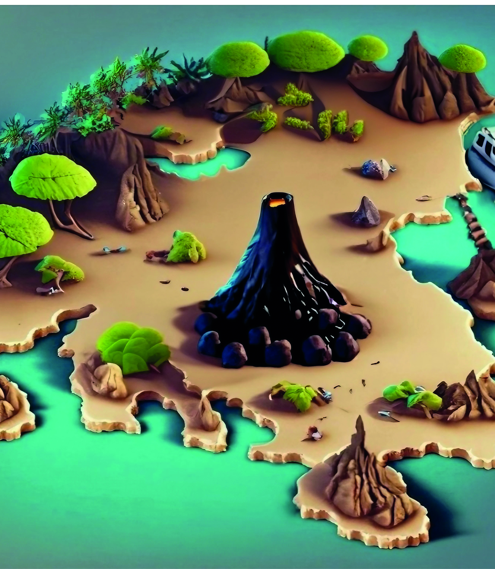
Context
A yacht is shipwrecked on a desert island. The boat's X castaways find themselves on this island and have to find a way out.
A volcano threatens to erupt and you must leave the island within 60 minutes at the latest.
Objective => All players must leave the island safely
In order to complete this objective you must discover every contrains existing (players and environement) and find enough objects and resources to build your raft.

Slide 6


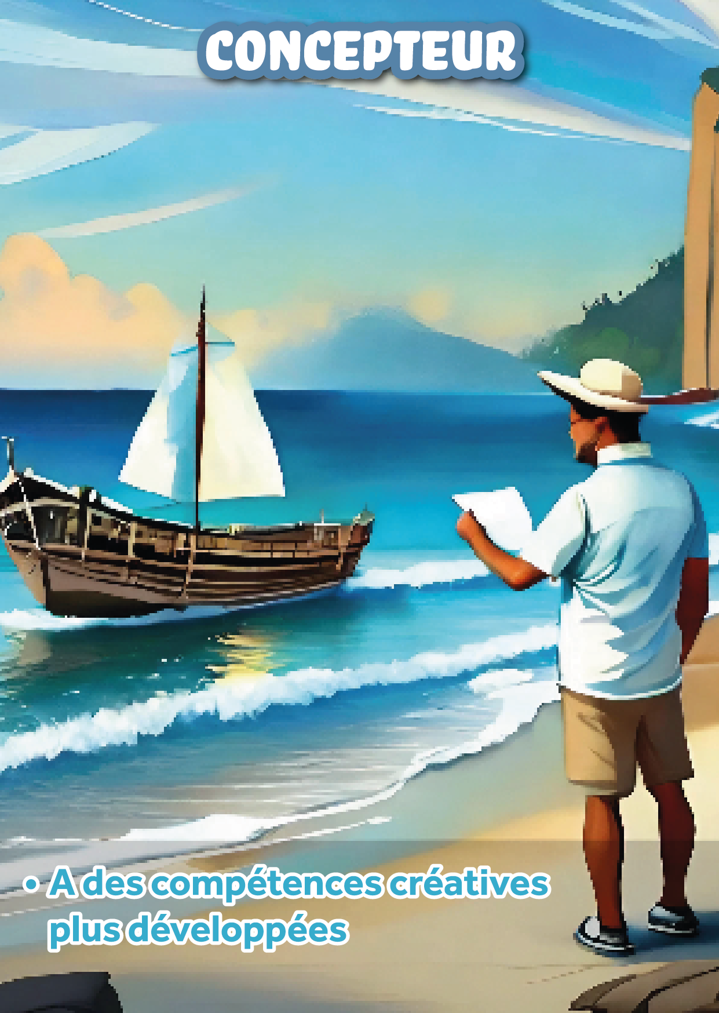

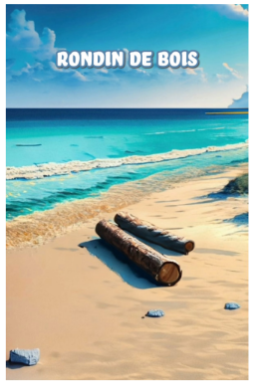
Presentation of the various cards
Characters
(front & back)
Must be placed on the table, face up
There is information on the back, which you can read, but not to reveal them
Objects
Methods
Resources

Slide 7
Mechanics of the game
Turn-based game
Action possible individually per turn:
Fetch water (draw pile)
Fetch wood (draw pile)
Draw shipwreck card (draw pile)
Choose to apply the observation method (7 differences game)(1 difference = 1 card)
Choose to apply the interview method to 1 person
Action linked to character cards (power specific to the character)
At the end of each round, the group decides to leave the island. You have 10 minutes to build your raft.
Success => Congratulations, the game is over
Failure => You draw a ‘Chance’ card

Slide 8
YOUR ADVENTURE STARTS NOW!

